Slide 1
Evaluating online sources
5-minute workshop

Slide 2
How do you decide if an online source is trustworthy?
Authorship: Who wrote this and what are their credentials?
Publisher: Who sponsors the document? Is this institution biased?
Educational website = .edu
Non-profit organizations and public interest groups = .org
Government agencies = .gov or .fed
Commercial sites = .com or .net
Point of view: What is the author’s goal?
Verifiability: Can you verify the information the author references? What kind of information do they cite?
Currency: Is the information current? See copyright/update at foot of web page.

Slide 3
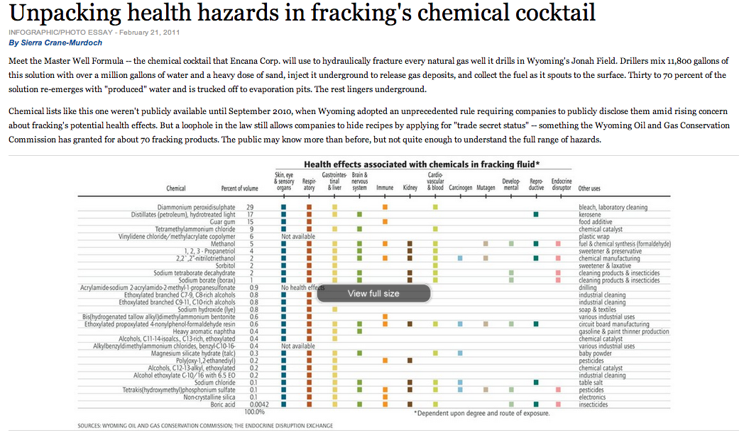
Would you cite this source? www.hcn.org

Slide 4
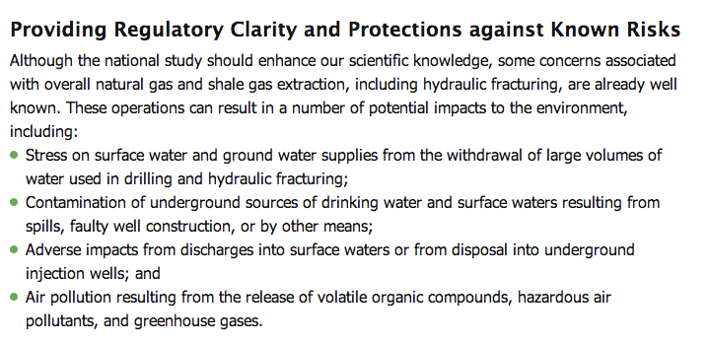
Would you cite this source? www2.epa.gov

Slide 5
Would you cite this source? www.propublica.org

Slide 6
Would you cite this source? www.sgmeet.com
Notes:
Note that abstracts from conferences are not peer reviewed.

